Slide 1
Exploring the Problem Space

Slide 2
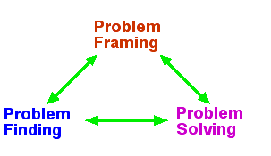
Problem Solving Process
This activity focuses on problem finding

Slide 3
Case Study:
Instructor: change text (XXX) in slides to your specific case
Vague, messy
Difficult to understand
Explore the problem space
Structure the problem space
Systems thinking about the problem
Clarified
Simplified
Separated

Slide 4
Explore the problem space
Goal: Learn strategies for problem structuring across disciplines using XXX as an example
NOT to “get it right”
You will be guessing at many of the processes and relationships that you will be modeling

Slide 5
Successful research teams
Participatory, inclusive and empowering leadership style
Learning each other’s perspectives
Development of common ground
Adaptability and flexibility
Development of a shared vision
Pennington (2011)

Slide 6
Problem framing
Depends on the people at hand
Emerges from the development of a cognitive ecosystem
Depends on interactions between individual learning and group processing
Facilitated by individual and group skills

Slide 7
Activity: Explore the Problem Space
Three groups; three problem frames
Goal: Co-create an issue map of the XXX
Individually: Create an issue map representing your perspective combined with the perspectives in the research article you read (30 minutes)
Co-create issue map (90 minutes)
Report out (20 minutes)

Slide 8
Co-create issue map
START: Spend 20 minutes working individually to create a mind map from your perspective, using provided paper, markers, and sticky notes
One at a time, spend about 10 minutes explaining your issue map. Remember: active listening, thoughtful questions, jargon avoidance, teaching and learning
THEN, co-create an issue map
Take a break when convenient for the team

Slide 9
Groups report out
Select a spokesperson
In 5 minutes provide a brief overview of your mind map

